Slide 1
Coursera Capstone 2021 City of opportunity: Mumbai authored by yash

Slide 2
Introduction
Mumbai is the commercial capital of India.
Mumbai developed a highly diversified infrastructure.
With its diverse society, comes diverse infrastructure which decides the quality of living.
When one moves to a new city like Mumbai, is where to find a good area to build and grow prosperously.
The purpose is to help people in exploring better facilities around their neighborhood.

Slide 3
Data acquisition and cleaning
The questions I aim to answer in this project are the following:
1. List and visualize all major parts of Mumbai City with top existing infrastructure.
2. What are the best locations in Mumbai as per infrastructure?
3. Which areas have the potential for the development of infrastructure of different kinds?
4. Which all areas lack the infrastructure facilities?
5. What is the best place to stay within a city for all vital infrastructure facilities?

Slide 4
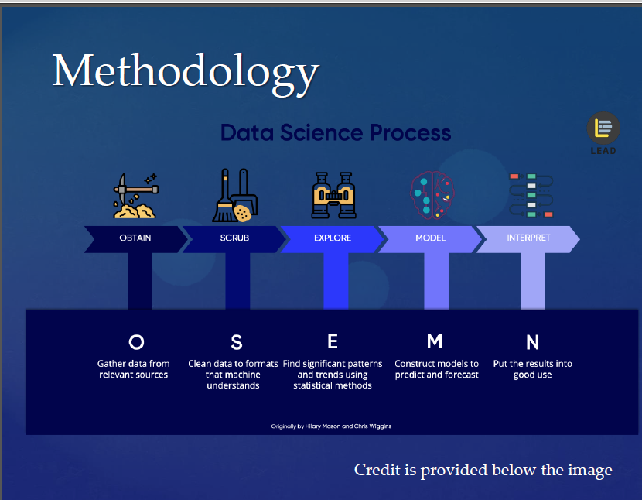

Slide 5
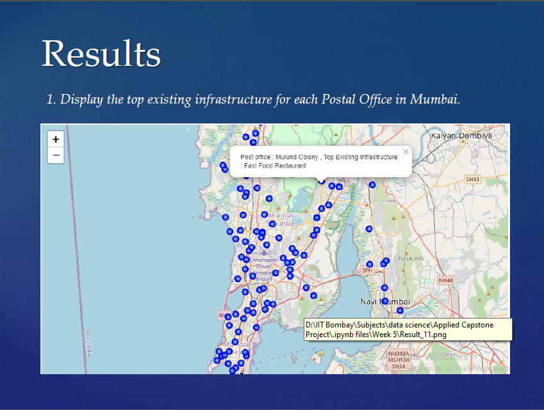

Slide 6
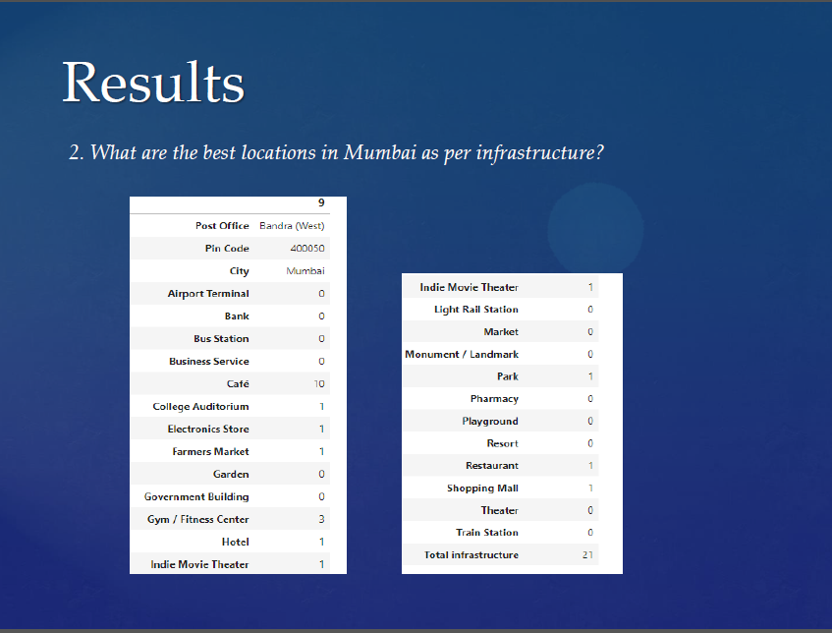

Slide 7
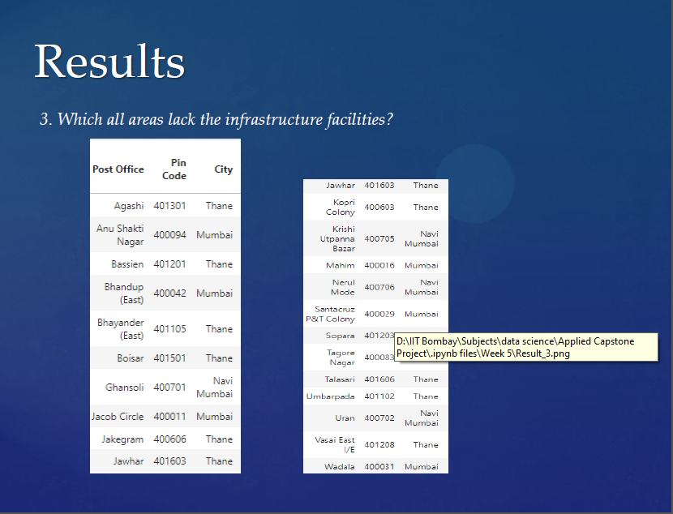

Slide 8
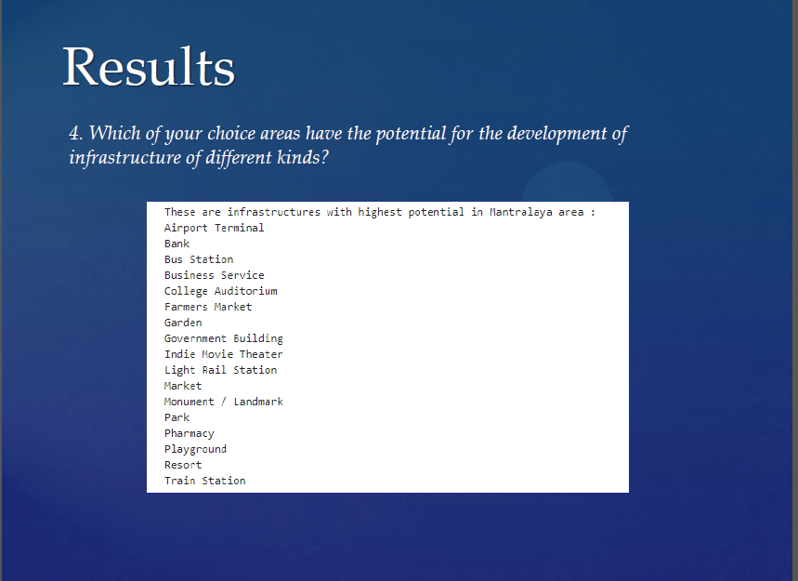

Slide 9
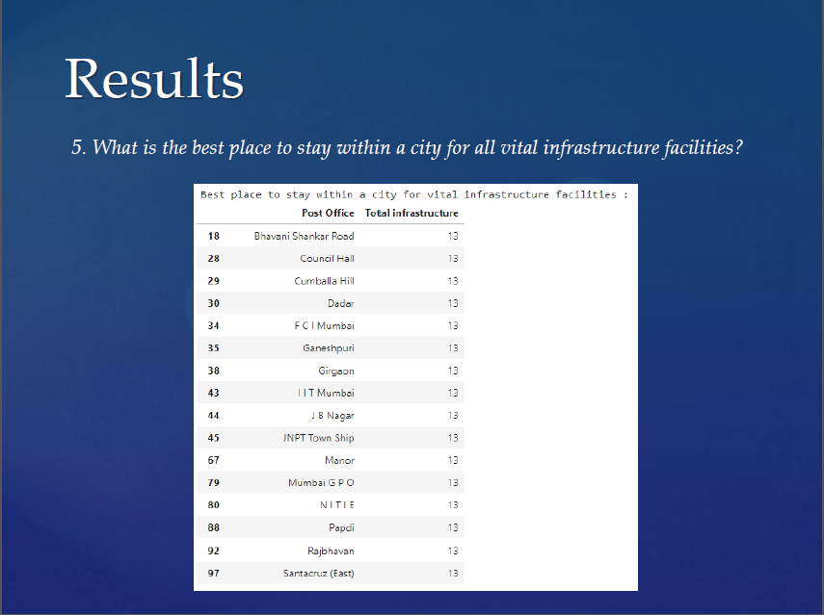

Slide 10
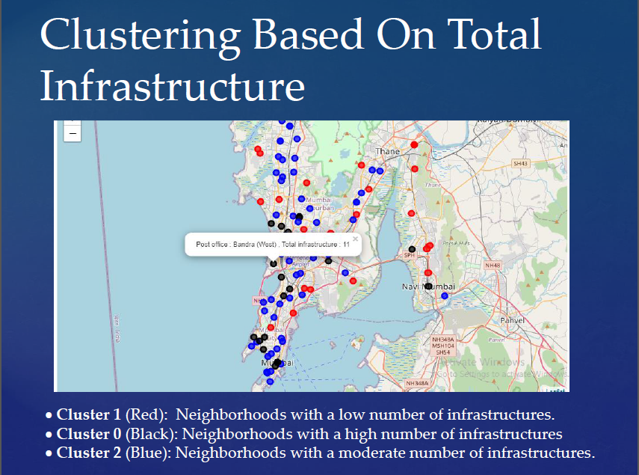

Slide 11
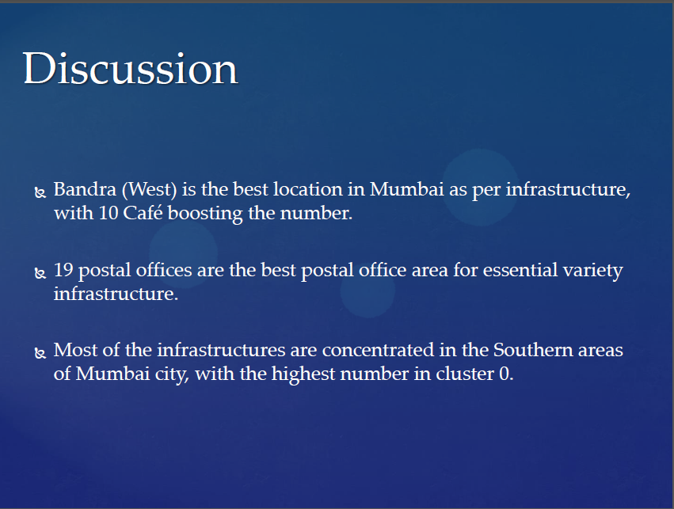

Slide 12
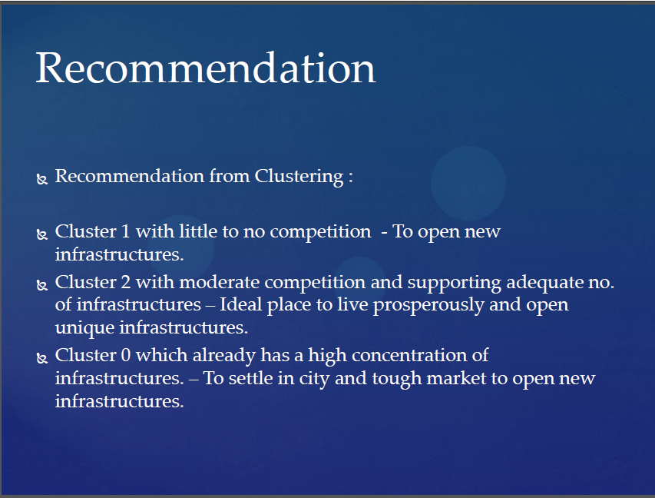

Slide 13
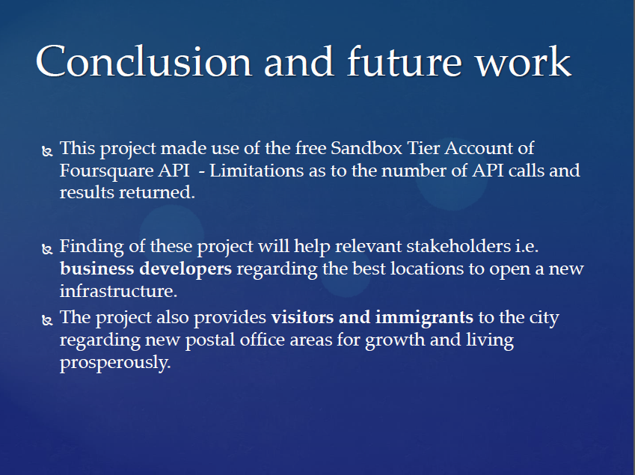

Slide 14
Thank you
Submitted by yash rajput

